Slide 1
FPGA Acceleration for Graph Application
Team 50
양이창
송영석
윤하은

Slide 2
Contents
Background
Graph
FPGA
Proposed
Interface
FPGA design
Experiment
Conclusion

Slide 3
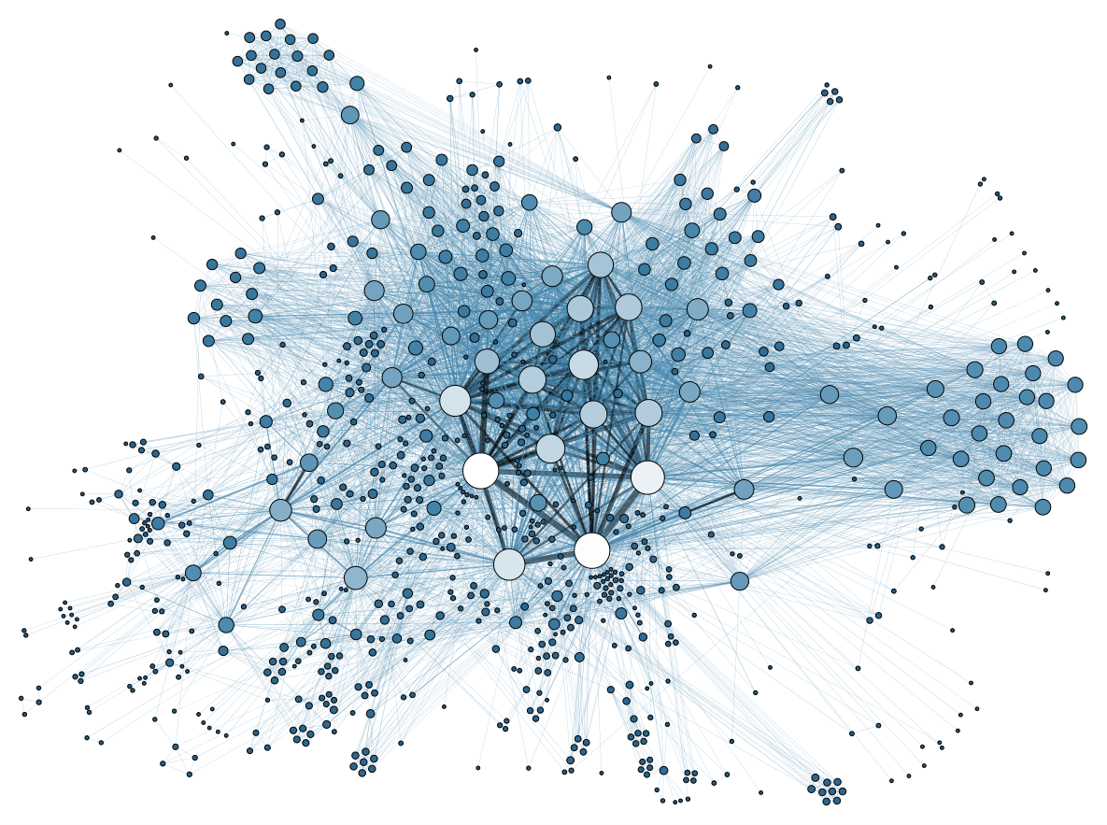
Background
Graph
data set structure, consisting of Vertices and Edges
Major interest, due to increasing network systems in modern day life
Google maps(Navigation systems)
SNS, World Wide Web
Genome analysis, medical usage
Image recognition, data mining

Slide 4
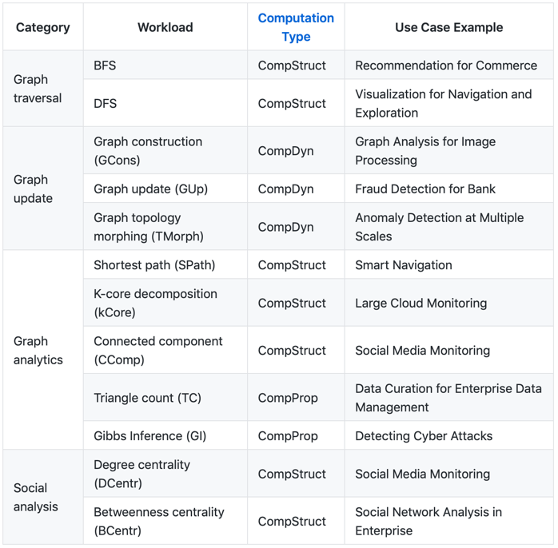
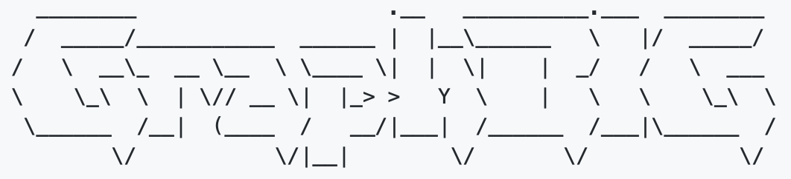
Background
GraphBIG
Open source benchmark suites for graph computing
Application medium selected as a control in this research
Provided deeper insight on graph computing
Dev by Georgia Tech and IBM

Slide 5
Background
Motivation ( Performance enhancement )
- Increasing infrastructure size and dependency on graph computing
- Heavy load and tedious calculation that is not suited for modern day computers
- High potential for improvement and greater efficiency
- GraphBIG benchmarks and underlying framework are C++ codes with STL(standard library in CPP)
-> 1) We can accelerate application at the point of hit rate using our own data structure.
-> 2) Construct the module in parallel structure to accelerate.
- CPU calculate in 64bit ( or 32 bit ) when transferring the data.
-> With FPGA, we can widen the DRAM data in 1024 bit width. ( Better bandwidth ).

Slide 6
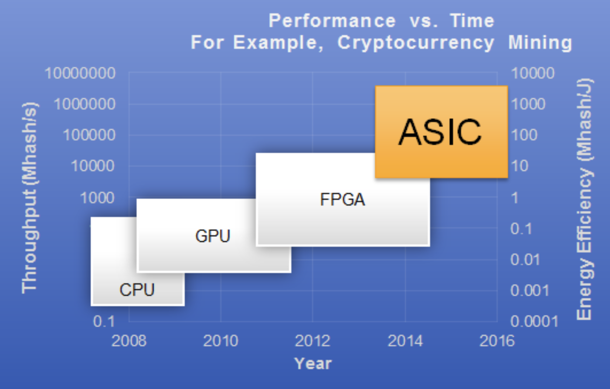
Background
FPGA
Field programmable gate array
It is an integrated circuit designed to be configured by a customer or a designer.
We can design the logic gates in hardware level with our own designed modules using HDL (hardware description language).
=> Design better performance processing unit for our graph application calculation.

Slide 7
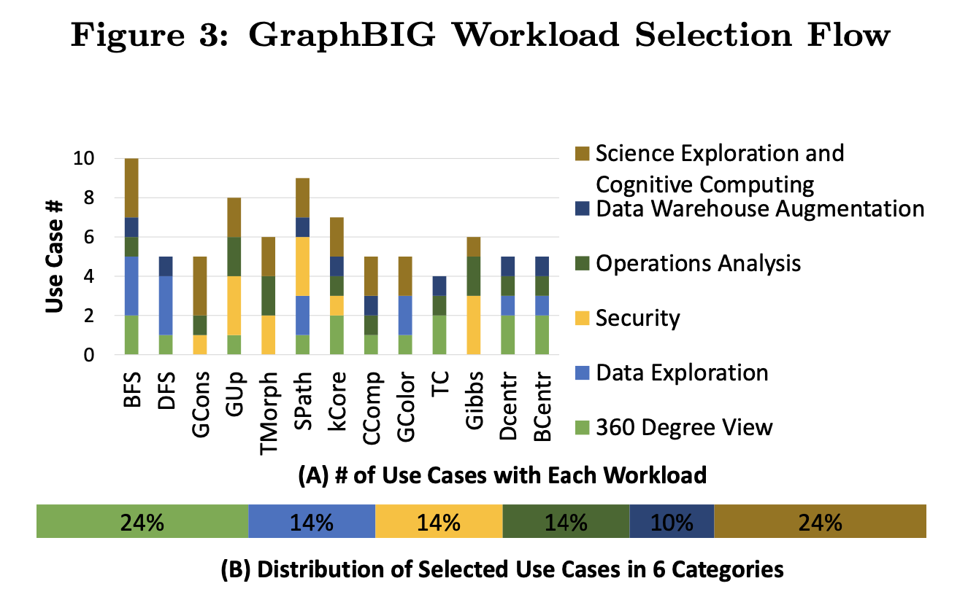
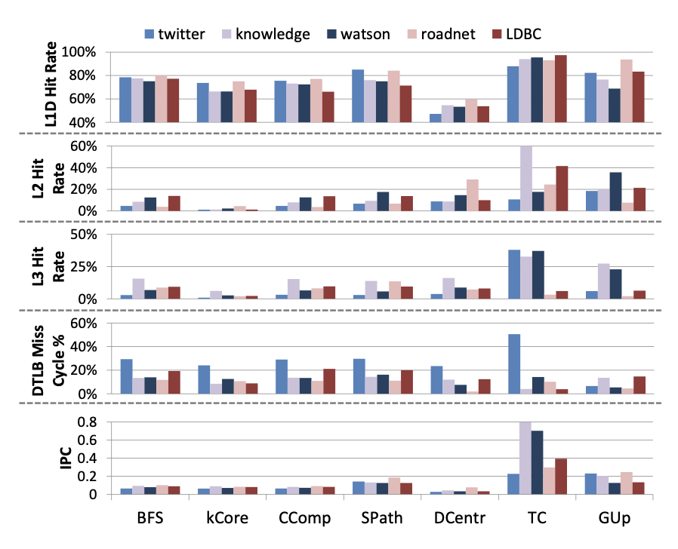
Background
Single Source Shortest Path
Single Source Shortest Path
Navigation, graph analysis
Why SSSP?
Simple algorithm but heavily dependent on memory access
Low Cache hit rate, High miss rate
Comparably higher IPC -> lower is better
Variety of algorithms

Slide 8
Proposed
Accelerator Overview
GraphBIG
Data Construction
stage
Calculation
stage
Notes:
Explain our Accelerator briefly, it has data part and calculation part
저희가 작업한 Acc의 전체적인 구조를 간단하게 설명드리면
크게 Data 파트와 Calculation 파트가 있다.

Slide 9
Proposed
Acceleration Overview - Data stage
GraphBIG
Data Construction
stage
Calculation
stage
We construct better bandwidth DRAM with
Read/Write 1,024 bit at a time
15 numbers of node datas in one packets ( Higher hit rate )
Notes:
At the Data stage We construct better bandwidth DRAM
first Read write 1,024bit at a time
and 15numbers of node datas in one packets (Those make higher hit rate)
는 1,024bit 단위로 읽고 쓰며
특히 노드 데이터는 15개씩 묶어서 읽는다.

Slide 10
Proposed
Acceleration Overview - Calculation stage
GraphBIG
Data Construction
stage
Calculation
stage
1)Find minimum
2) Calculate the shorter path
3) Update
Notes:
Calculation stage has three parts

Slide 11
Proposed
Acceleration Overview - Calculation stage
1)Find minimum
2) Calculate the shorter path
3) Update
We construct pipe-lined structure to accelerate finding minimum
Notes:
First is find minimum
We construct pipe-lined structure to accelerate finding minimum

Slide 12
Proposed
Acceleration Overview - Calculation stage
1)Find minimum
2) Calculate the shorter path
3) Update
We construct pipe-lined structure to accelerate finding minimum
In calculating the shorter path, parallelized-calculation modules
Notes:
and second calculate the shorter path
in calculating the shorter path, parallelized calculation modules.

Slide 13
Proposed
Architecture
PC
FPGA
CPU
DRAM
Accel
AXI
APB-AXI
AXI
APB-AXI
PCIE
SFR
(BRAM)
Notes:
our total architecture is this.
left side is PC and right side is fpga
both are connected with pci port
우리의 전체적인 아키텍쳐는 이렇다
왼쪽은 PC고 오른쪽은 FPGA다
각 부분의 자세한 설명은 뒤에서 하겠다.

Slide 14
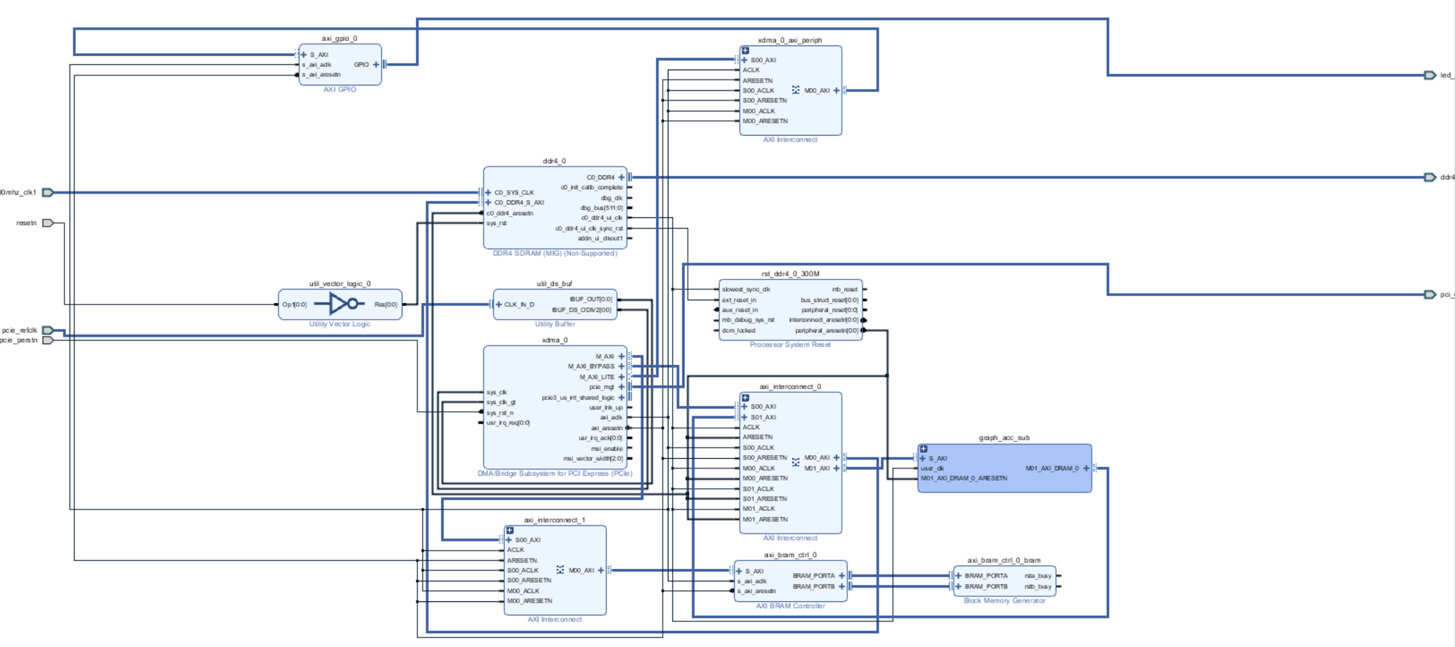
Proposed
Architecture (block diagram)
CPU
DRAM
Accel
AXI
APB-AXI
AXI
APB-AXI
PCIE
SFR
(BRAM)
Notes:
this is our fpga’s detail block diagram
this architecture is show briefly previous page.

Slide 15
Proposed
Interface
CPU -> PCIE -> DRAM, SFR
Data preprocessing & Write data to DRAM
Check the result and measure the execution time
PC
FPGA
CPU
DRAM
RESULT
Accel
AXI
APB-AXI
PCIE
AXI
APB-AXI
SFR
(BRAM)
Notes:
So i make the interface.
interface do data preprocessing and move data from pc to fpga memory
and last check the result output and measure the execution time

Slide 16
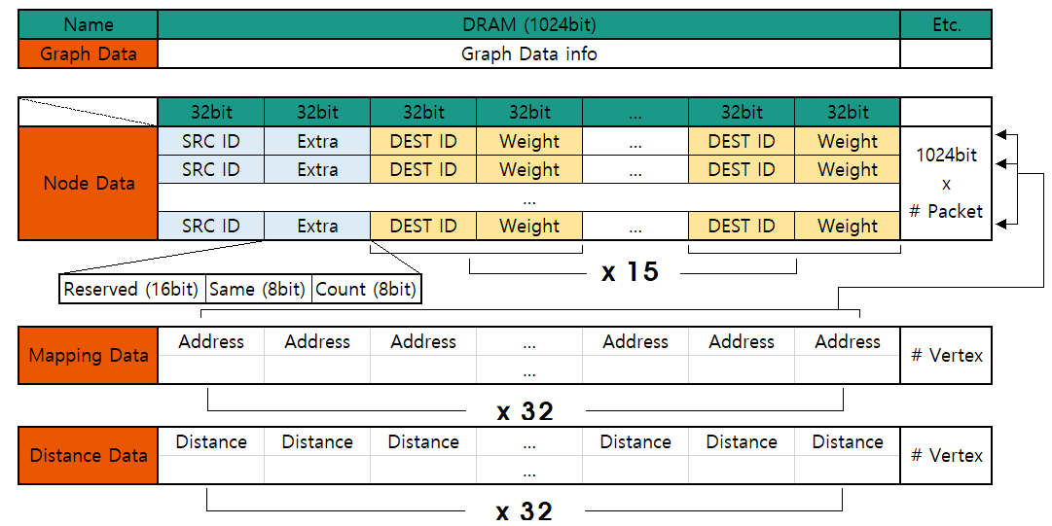
Proposed
Data preprocessing
DRAM
Graph Data
Node Data
Mapping Data
Distance Data
Notes:
Node data is made of packets
in one packet 32 blocks grouped
first block is source node id and
second block is extra data. in extra data Reserved region 16bit, is same 8bit, count 8bit
and next 30 blocks are 15 bundle
at one bundle is destination id and edge weight
// mapping 과 distance 를 sequential 하게 배치하였기 때문에 address 는 base + offset 으로 바로 접근할 수 있다. => 속도 향상인 부분인가??

Slide 18
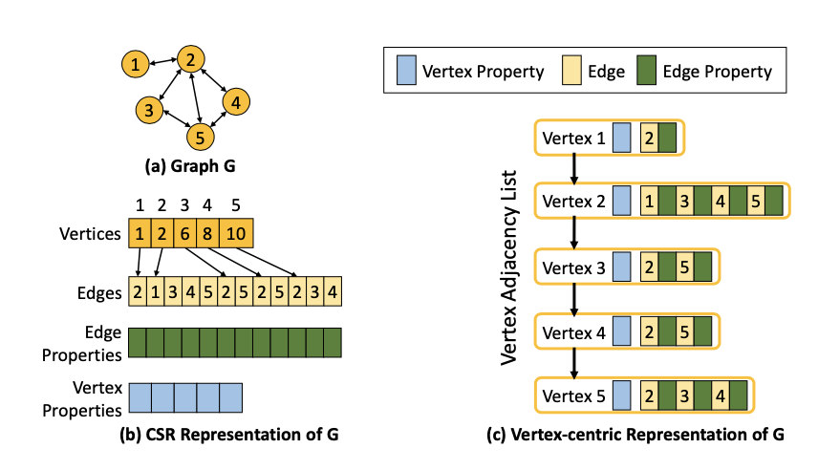
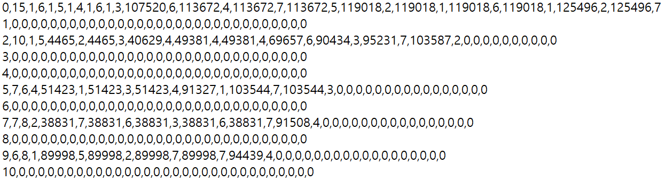
Proposed
Interface
One information is 32bit
Read/write 1,024bit at a time (32bit x 32)
Decrease number of Read/write time & Increase throughput (hit rate higher)
Total bandwidth increase.
Notes:
정보 한개는 32bit지만, DRAM에서 read, write 하는 횟수를 줄이기 위해 32bit의 정보 32개를 묶어 한번에 처리하도록 설계했다.
We design data by 1024 bit, increase throughput 따라 decrease read write (hit rate가 증가)
이 두가가지 요인인으로 전전체 bandwidth가 증가하였다.

Slide 20
Proposed
FPGA design - Acceleration module
Operate the graph application(SSSP)
Use Verilog HDL
PC
FPGA
CPU
DRAM
RESULT
Accel
AXI
APB-AXI
PCIE
AXI
APB-AXI
SFR
(BRAM)

Slide 21
Proposed
FPGA design
Acceleration module
Dijkstra Algorithm : finding the shortest path.
DRAM
SSSP module
Find distance of all neighboring nodes,
Update minimum distance
Graph Data
Node Data
Mapping Data
FIND module
Find Next node
and Indicate visit nodes
Distance Data
Notes:
FPGA design is as shown in the picture.
In DRAM, data are set sequentially. Graph info, node data...
there are two modules. SSSP calculates and updates the shortest path, FIND module finds next node to be calculated.
we designed it based on dijkstra algorithm which is the algorithm that calculates the shortest path from start node to all other nodes.

Slide 22
Proposed
FPGA design - SSSP module
SSSP module
1) Initialize
READ Node data based on corresponding Mapping data
DRAM
SSSP module
Find distance of all neighboring nodes,
Update minimum distance
Calculate the shortest path
using dijkstra algorithm
Graph Data
Node Data
Mapping Data
FIND module
Find Next node
and Indicate visit nodes
Distance Data
WRITE to Distance data

Slide 23
Proposed
FPGA design - SSSP module
SSSP module
2) Read node data
READ Node data based on corresponding Mapping data
DRAM
SSSP module
Find distance of all neighboring nodes,
Update minimum distance
Calculate the shortest path
using dijkstra algorithm
Graph Data
Node Data
time : O(1)
Mapping Data
FIND module
Find Next node
and Indicate visit nodes
Distance Data
WRITE to Distance data
Notes:
Accel 아닌가??

Slide 24
Proposed
FPGA design - SSSP module
SSSP module
3) Calculate
READ Node data based on corresponding Mapping data
weight-added path < original path ?
DRAM
SSSP module
Find distance of all neighboring nodes,
Update minimum distance
Calculate the shortest path
using dijkstra algorithm
Graph Data
Node Data
Mapping Data
FIND module
Find Next node
and Indicate visit nodes
Distance Data
WRITE to Distance data

Slide 25
Proposed
FPGA design - SSSP module
SSSP module
4) Write
READ Node data based on corresponding mapping data
DRAM
SSSP module
Find distance of all neighboring nodes,
Update minimum distance
Calculate the shortest path
using dijkstra algorithm
Graph Data
Node Data
Mapping Data
FIND module
Find Next node
and Indicate visit nodes
Distance Data
WRITE to Distance data

Slide 26
Proposed
FPGA design - FIND module
FIND module
1) FIND module gets the signal from SSSP
READ and FIND
READ unit
READ the Distance Data
FIND unit
Find the minimum value
DRAM
SSSP module
Find distance of all neighboring nodes,
Update minimum distance
Graph Data
Node Data
Mapping Data
FIND module
Find Next node
and Indicate visit nodes
WRITE unit
Write the minimum distance data as visited(Checked) then send the minimum distance data to SSSP module to calculate the shorter path.
Distance Data

Slide 27
Proposed
FPGA design - FIND module
FIND module
2) It explore all Distance Data.
READ and FIND
READ unit
READ the Distance Data
FIND unit
Find the minimum value
DRAM
SSSP module
Find distance of all neighboring nodes,
Update minimum distance
Graph Data
Node Data
Mapping Data
FIND module
Find Next node
and Indicate visit nodes
WRITE unit
write the minimum distance data as visited(Checked) then send the minimum distance data to SSSP module to calculate the shorter path.
Distance Data

Slide 28
Proposed
FPGA design - FIND module (Acceleration)
READ and FIND
READ unit
READ the Distance Data
FIND unit
Find the minimum value
Parallelized structure of find module(Read & Find)
1 µs
2 µs
3 µs
4 µs
5 µs
6 µs
Time
Read
Find
Read
Find
Read
Find

Slide 29
Proposed
FPGA design - FIND module
FIND module
READ and FIND
READ unit
READ the Distance Data
FIND unit
Find the minimum value
DRAM
SSSP module
Find distance of all neighboring nodes,
Update minimum distance
Graph Data
Node data
Address Map
FIND module
Find Next node
and Indicate visit nodes
WRITE unit
write the minimum distance data as visited(Checked) then send the minimum distance data to SSSP module to calculate the shorter path.
Distance Result

Slide 30
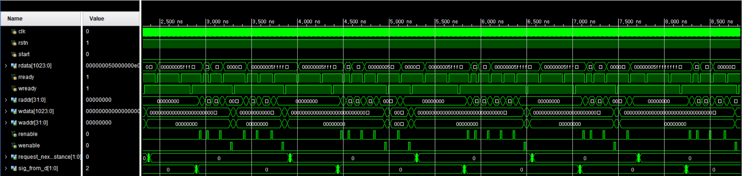
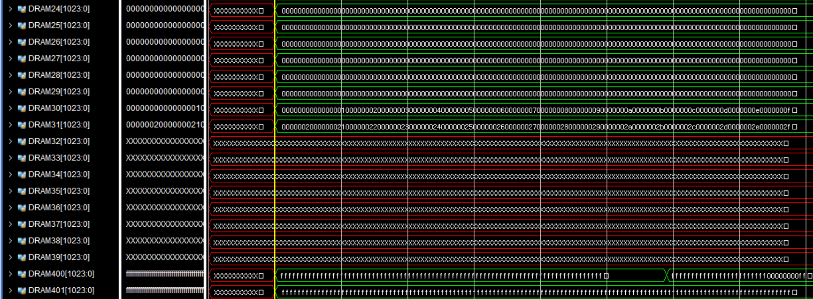


Experiment
Waveform Simulation with sample data
Initial distance data ( set as infinite value )
Intermediate processing distance data
Final distance data ( result )

Slide 31
Experiment
Evaluation
We have now completed the simulation phase and are in the process of uploading data from PCIE to DRAM with the designed interface.
the evaluation of the experiment was carried out with the predicted value and measured by calculating the number of clocks in the simulation and multiplying it with the clock speed of the FPGA board.
CPU
DRAM
RESULT
Accel
AXI
APB-AXI
PCIE
AXI
APB-AXI
SFR
(BRAM)
Notes:
현재 시뮬레이션 단계까지 완료하였으며 PCIE 에서 DRAM으로 데이터를 올리는 단계의 진행중에 있다.
따라서 실험의 평가는 예측값으로 진행하였으며 시뮬레이션에서 clock 횟수를 계산하고 FPGA Board의 clock speed를 곱하는 방식으로 측정하였습니다.

Slide 32
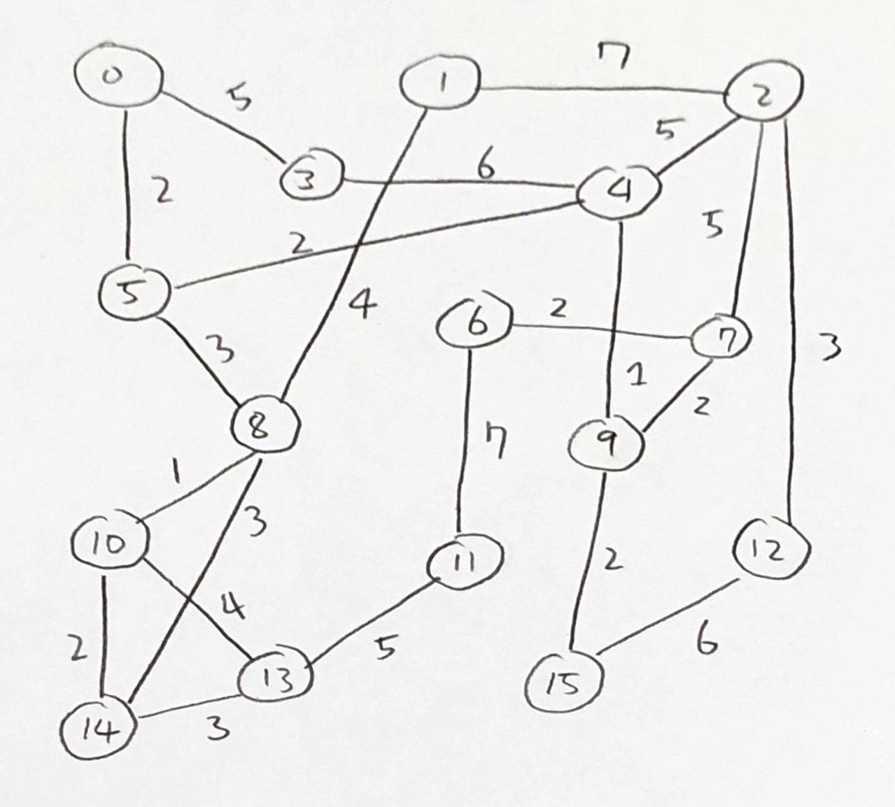
Experiment
FPGA Evaluation
Simulation run on 3 different synthesized datasets, and one real world dataset
Synthesized
16 vertices
100 vertices
1000 vertices
Real world
138,614 vertices

Slide 33
Experiment
Evaluation
 | PC specs | FPGA specs
Bandwidth | 64 bit | 1024 bit
Clock Speed | 2.0 GHz | 300 MHz
Real-world data (138,614 nodes 1,394,825 edges), data :IBM-knowledge repo
 | PC(GraphBIG Benchmark) | FPGA(expectation) | Performance ( FPGA / PC )
Graph construction | 37.32 sec | 54 sec | 144.7%
Calculation | 137.30 sec | 2.806 sec | 2.04%
Total duration | 174.62 sec | 56.806 sec | 32.5%

Slide 34
Experiment
Evaluation (How to calculate the expectation data)
Since the data for simulation on FPGA is too big, we calculate the duration time based on 16 nodes data.
<SSSP module>
( Average of READ packet cycles + READ address map cycles + READ&WRITE distance cycles ) * clock speed (⅓ ns)
+
<FIND module>
( Constant cycles of FSM + cycles based on MAX nodes ) * clock speed = { (25cycles) +(14*(MAX # of node)/32 ) } *(⅓ ns)

Slide 35
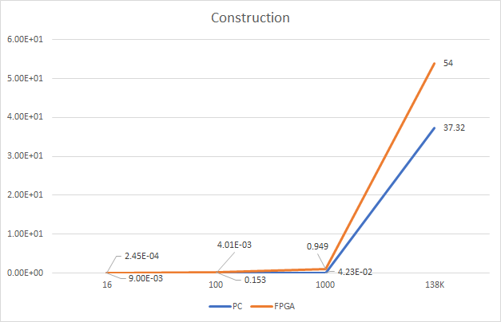
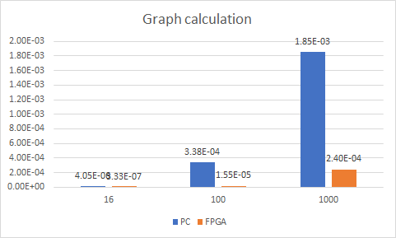
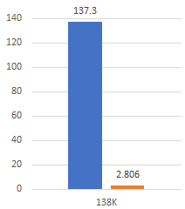
Experiment
Evaluation : PC(GraphBIG) vs FPGA

Slide 36
Conclusion
Further objectives
Accomplish proper communication between PC and FPGA
Test out different types of dataset and compare the acceleration effect
Reduce clock cycles that are unnecessary to the computation
Design ‘Data preprocessing part’ to FPGA

Slide 37
Reference
Research papers
GraphBIG: Understanding Graph Computing in the Context of Industrial Solutions,Lifeng Nai, Georgia Institute of Technology, Atlanta GA, IBM Thomas J. Watson Research Center
An FPGA Implementation for Solving the Large Single-Source-Shortest-Path Problem,Guoqing Lei, Yong Dou, Rongchun Li, and Fei Xia
Accelerating Large-Scale Single-Source Shortest Path on FPGA, Shijie Zhou, Charalampos Chelmis, Viktor K. Prasanna
FPGA Based Binary Heap Implementation: With an Application to Web Based Anomaly Prioritization,Md Monjur Alam,Georgia State University

Slide 38
Experiment
Evaluation
 | PC specs | FPGA specs
Bandwidth | 64 bit | 1024 bit
Clock Speed | 2.0 GHz | 300 MHz
Sample data (16 nodes 43 edges)
 | PC(GraphBIG Benchmark) | FPGA accel | Performance (FPGA/PC)
Graph construction | 2.45094e-4sec | 0.009 sec | 3672%
Calculation | 4.05312e-6 sec | 3.33e-7sec | 17.84%
Total duration | 2.492e-4 sec | 0.009 sec | 3611.5%

Slide 39
Experiment
Evaluation
Sample data ( 100 nodes 3250 edges)
 | PC(GraphBIG Benchmark) | FPGA(expectation) | Peroformance ( FPGA / PC )
Graph construction | 4.01e-3 sec | 0.153 sec | 3815.4%
Calculation | 3.38e-4 sec | 1.55e-5 sec | 4.58%
Total duration | 4.35e-3 sec | 0.15302 sec | 3517.2%

Slide 40
Experiment
Evaluation
Sample data (1000 nodes 20790 edges)
 | PC(GraphBIG Benchmark) | FPGA(expectation) | Performance ( FPGA / PC )
Graph construction | 4.23e-2 sec | 0.949 sec | 2243%
Calculation | 1.85e-3 sec | 2.40e-4 sec | 12.9%
Total duration | 4.65e-2 sec | 0.949 sec | 2041%

Slide 41
Experiment
Evaluation
Real-world data (138,8604 nodes 1,394,825 edges), data :IBM-knowledge repo
 | PC(GraphBIG Benchmark) | FPGA(expectation) | Performance ( FPGA / PC )
Graph construction | 37.32 sec | 54 sec | 144.7%
Calculation | 137.30 sec | 2.806 sec | 2.04%
Total duration | 174.62 sec | 56.806 sec | 32.5%

Slide 42
FIND module
DRAM
SSSP module
Find distance of all neighboring nodes,
Update minimum distance
READ and FIND
READ unit
READ the Distance Data
FIND unit
Find the minimum value
Graph Data
Node Data
Mapping Data
FIND module
Find Next node
and Indicate visit nodes
Distance Data
WRITE unit
Write the minimum distance data as visited(Checked) then send the minimum distance data to SSSP module to calculate the shorter path.

Slide 43
1
2
3
4
5
6
7
Time
Read
Find
Read
Find
Read
Find
Read

Slide 44



Experiment
Evaluation : PC(GraphBIG) vs FPGA

